Slide 1

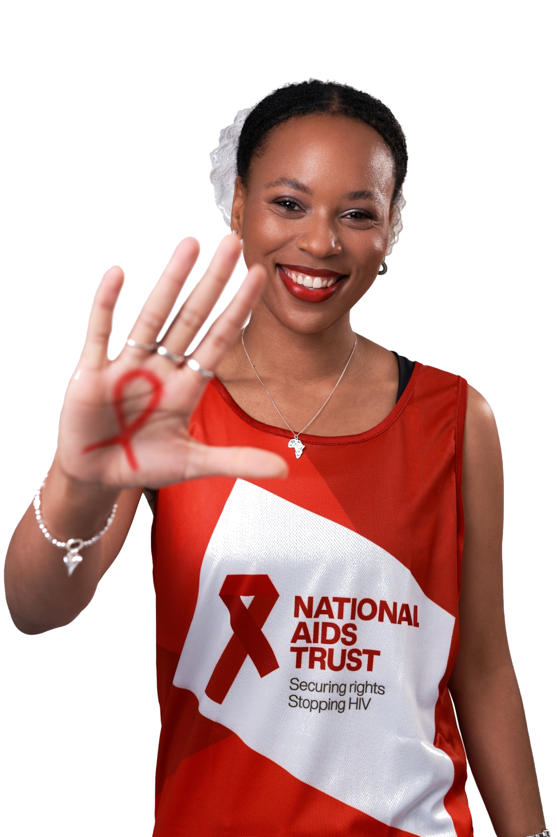

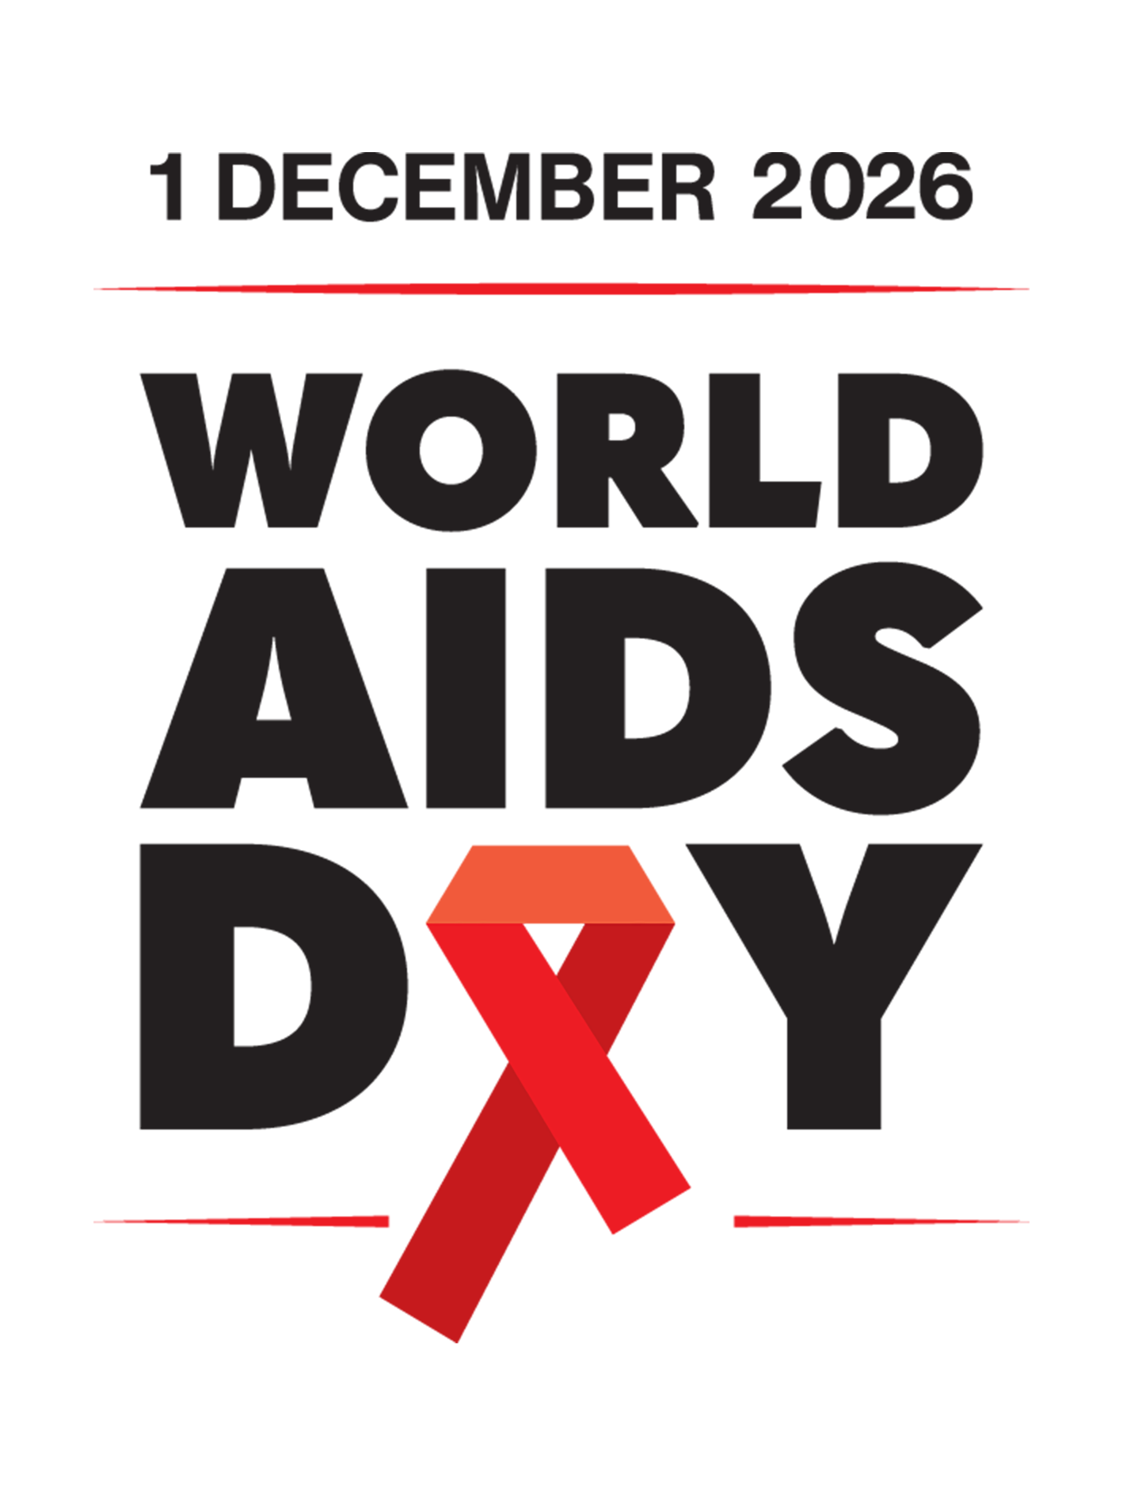

HIV in the UK

Slide 2

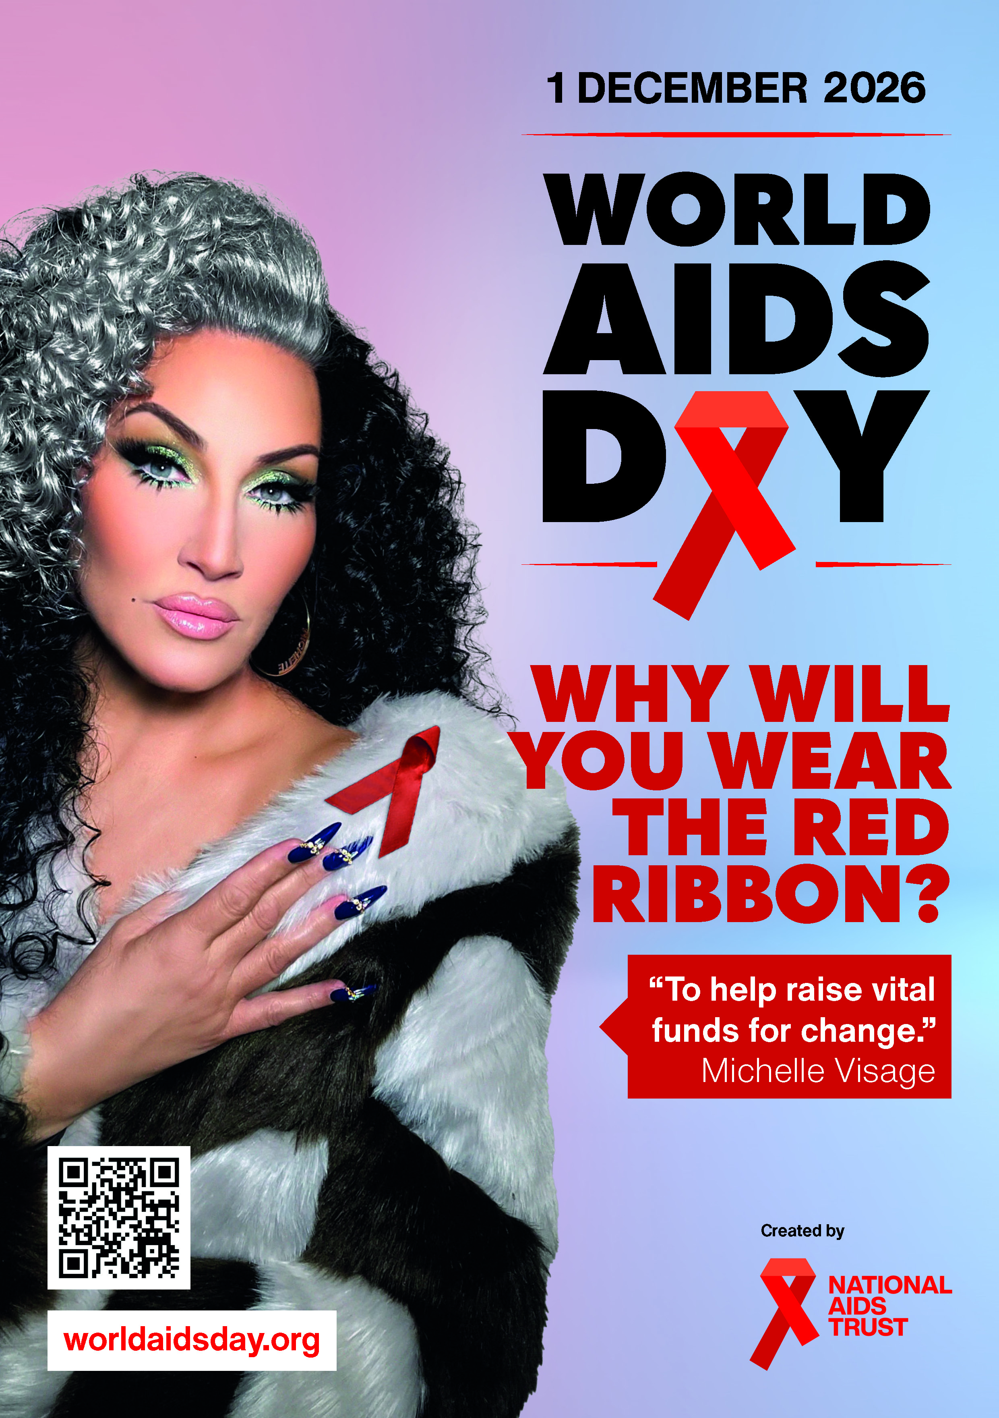
Overview
What is World AIDS Day?
What is HIV?
HIV treatment
HIV prevention
HIV in the UK
Living with HIV
How National AIDS Trust helps
How you can get involved

Slide 3
What is World AIDS Day?
World AIDS Day is held every year on 1 December every year to raise awareness about HIV.
World AIDS Day is an opportunity to:
Show support for people living with HIV.
Remember all those we’ve lost to AIDS-related illnesses.
Learn the facts and realities of HIV today, in the UK and worldwide.
Unite in the fight against new cases of HIV.

Slide 4
What is HIV?
HIV is a virus that attacks the body's immune system. It stands for Human Immunodeficiency Virus.​
​
​
AIDS stands for Acquired Immune Deficiency Syndrome. It is a serious illness that can develop when HIV damages the immune system to such an extent that it can no longer fight off a range of infections it would normally cope with. ​
HIV is the not the same as AIDS. ​
AIDS only develops if HIV is left untreated.

Slide 5
What is HIV?
HIV gets into the blood stream and disguises itself as part of your immune system, replicating instead of the T-cells that
co-ordinate your immune response. It can only be transmitted:
If it is present in sufficient quantity in blood, semen, vaginal fluid or breast milk. It is not transmittable through saliva, tears, sweat or waste products.
If it is good quality. HIV is easily damaged through exposure to air, water or detergent.
If there is an effective route of transmission.
There needs to be a direct route into the
blood stream.

Slide 6
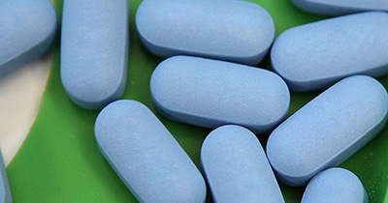
HIV treatment
HIV stays in the body for life, but treatment can keep the virus under control and the immune system healthy. Without medication, people with HIV can develop AIDS.
Treatment is now so effective that it reduces the amount of HIV in the body to undetectable levels within about six months, maintaining a healthy immune system and ensuring that the virus cannot be passed on.
Image Source: CDC

Slide 7
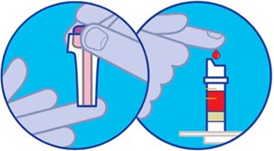
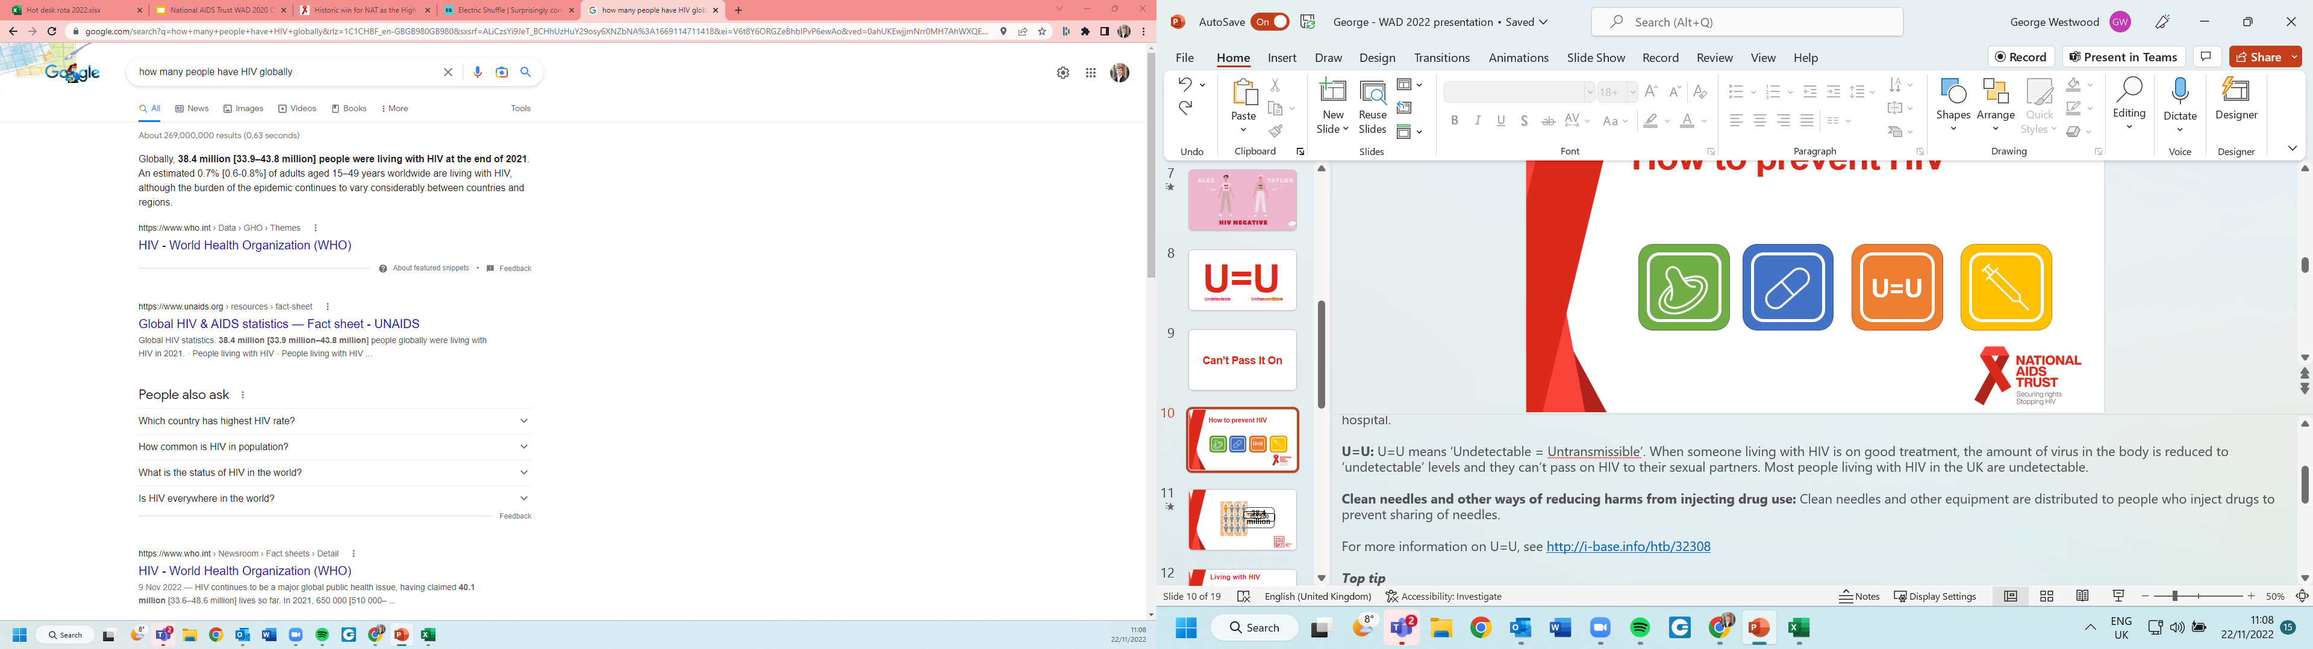
HIV prevention
Using condoms
#KnowYourStatus
Regular testing and taking PrEP or PEP (tablets which prevent HIV either before or after you have been exposed to it)
Undetectable = Untransmittable
Don’t share needles, syringes, or injecting equipment
Notes:
PrEP (Pre-exposure prophylaxis) is an HIV prevention pill available on the NHS.
PEP (Post-exposure prophylaxis) is a course of HIV medication that can be taken for up to 72 hours after being exposed to the virus to stop it replicating.
For those living with HIV, getting tested early and getting onto treatment means you can lower the virus to undetectable levels meaning you can’t pass the virus on.

Slide 8
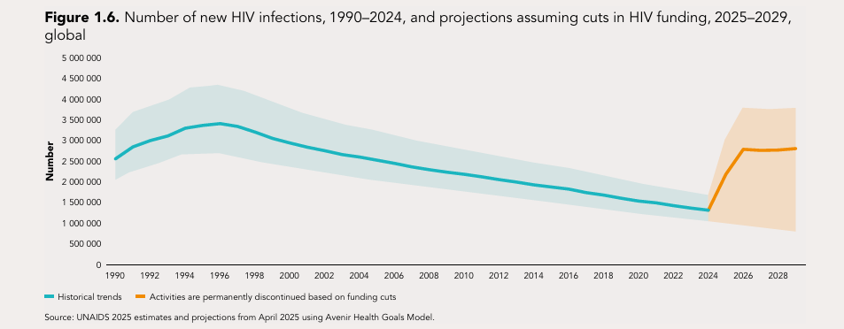
UNAIDS estimates in 2025
41.0 million were living with HIV globally
1.2 million people newly acquired HIV

Slide 9

HIV in the UK
There are currently over 110,000 people living with HIV in the UK.
In 2024, there were 3,043 new HIV diagnoses in the UK.
It's estimated over 5,200 people in the UK don't know that they're living with HIV, showing how important it is for everyone to test regularly.

Slide 10
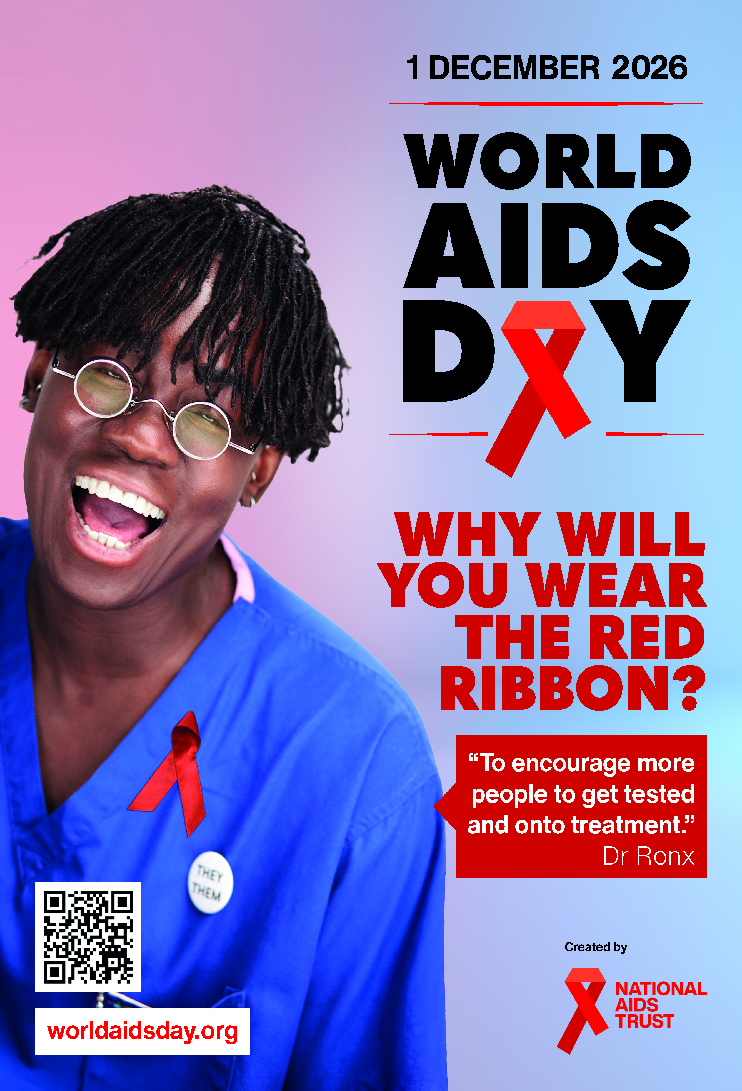
Accessing care in the UK
In the UK, HIV treatment is provided free of charge at specialist clinics within the NHS.
PrEP, the HIV prevention pill, is also available for free on the NHS. During 2024, 110,000 people accessed PrEP in sexual health clinics across England.
Almost all (99%) of the people who have been diagnosed with HIV in England, Scotland, and Wales are receiving treatment.
Around 98% of these people have an undetectable viral load.

Slide 11
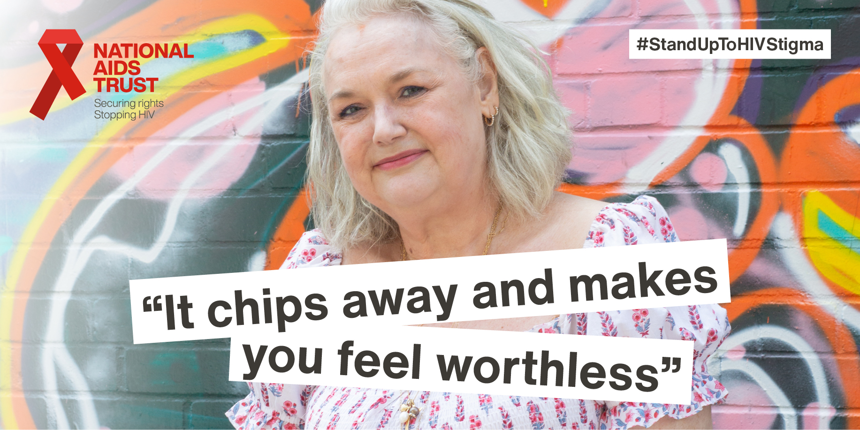

Living with HIV
HIV stigma: When people living with HIV are judged and treated badly because of prejudice and assumptions about HIV.
Notes:
Although we now have great treatment and people living with HIV can live long and healthy lives, they still experience HIV stigma.
When people living with HIV are judged and treated badly because of prejudice and assumptions about HIV, we call this ‘HIV stigma’.
Stigma persists because many people don’t understand the reality of HIV and are scared of it.
But people living with HIV deserve our respect and dignity, just like anyone else.

Slide 12
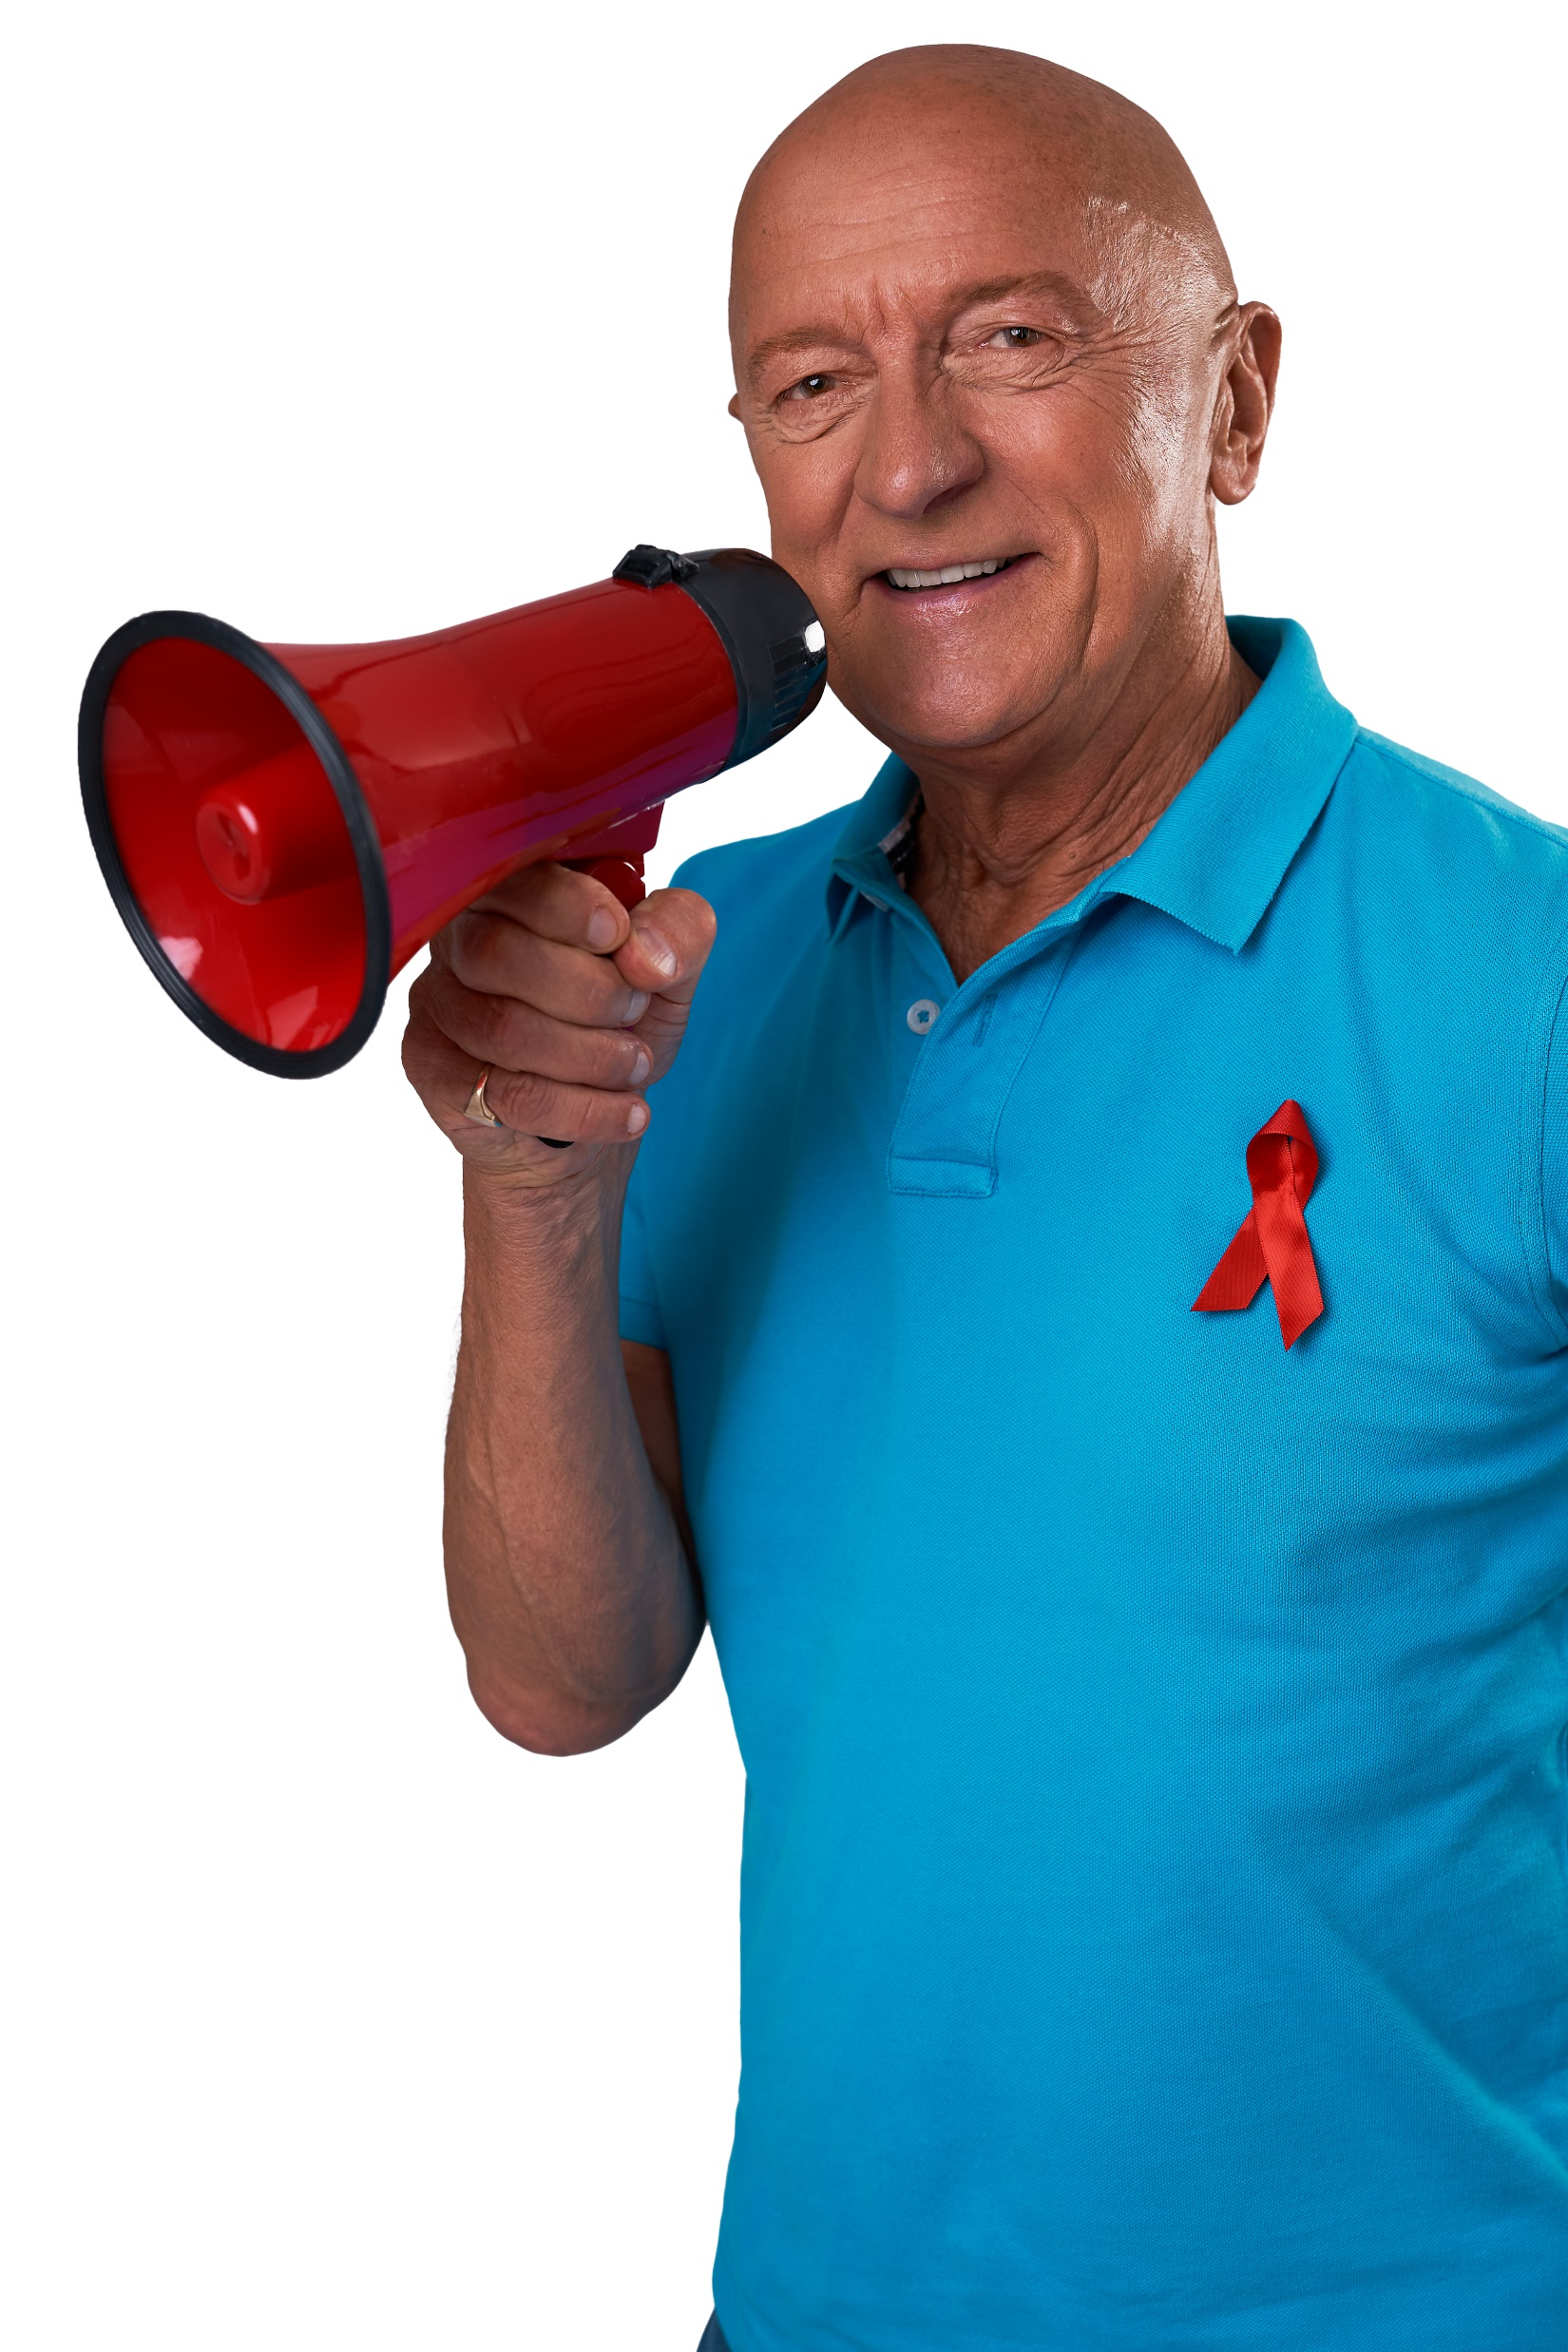
Living with HIV
The 2022 Positive Voices survey found that:
Reported stigma has improved slightly since 2017 but remains very high. Only 1 in 8 people had shared their HIV status with most people in their lives.
Since 2017 there has been little change in life satisfaction and quality of life among people living with HIV. Overall, compared to the general population, people living with HIV continued to fare slightly worse.
9 in 10 people living with HIV were aware of ‘Undetectable = untransmittable’ (U=U) however
only 6 in 10 believed strongly in the concept.

Slide 13
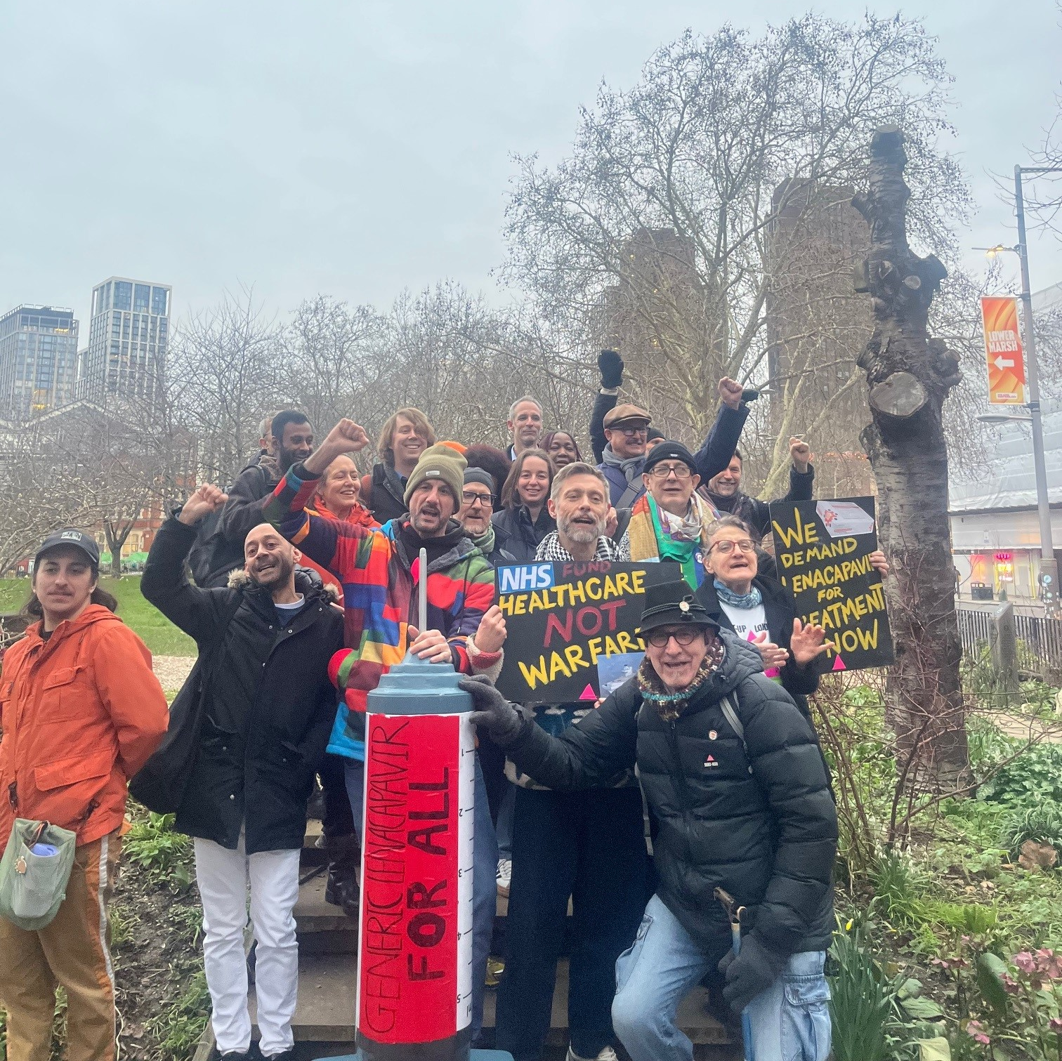
How National AIDS Trust helps
Supporting and advocating for people who have been discriminated against.
Working to end new HIV transmissions by 2030, through increase in education, prevention, testing and treatment.
Bringing together people living with HIV, politicians and other stakeholders to defend rights, change laws, policies and practices.
Researching, creating resources, making recommendations for and influencing change.

Slide 14
National AIDS Trust's impact
We have ensured:
PrEP, the HIV prevention pill is available free on the NHS.
Opt-out testing is now taking place in over 85 hospital emergency departments, which is proving highly successful in diagnosing new HIV cases.
HIV is recognised as a disability, giving people a host of legal protections from the moment of diagnosis.
Pre-employment questionnaires were made illegal– so employers can’t decide whether to offer someone a job based on HIV status.
More new mothers can access free formula milk to avoid HIV transmission.

Slide 15
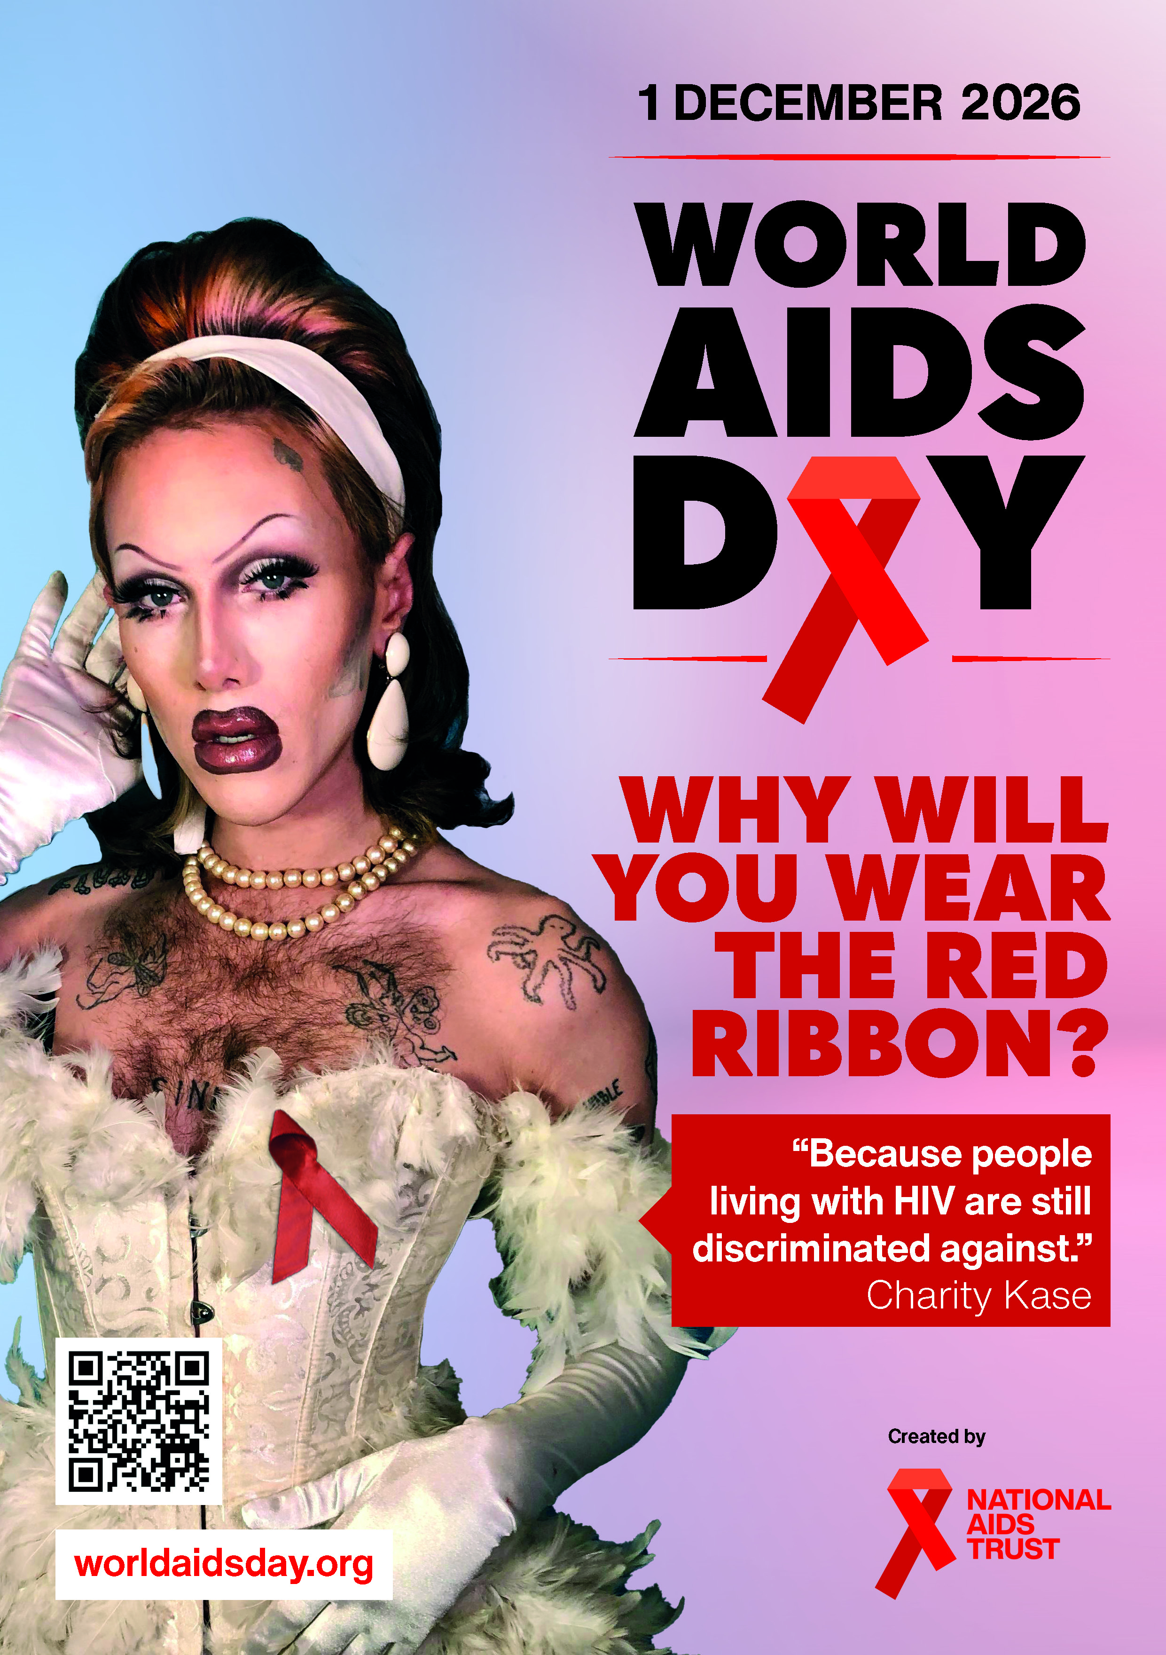
How you can support this World AIDS Day
and beyond!
Challenge HIV stigma online and in person
Organise a fundraiser for National AIDS Trust
Sign up for the newsletter
Share HIV information resources and our campaigns
Donate to National AIDS Trust
Volunteer for us

Slide 16
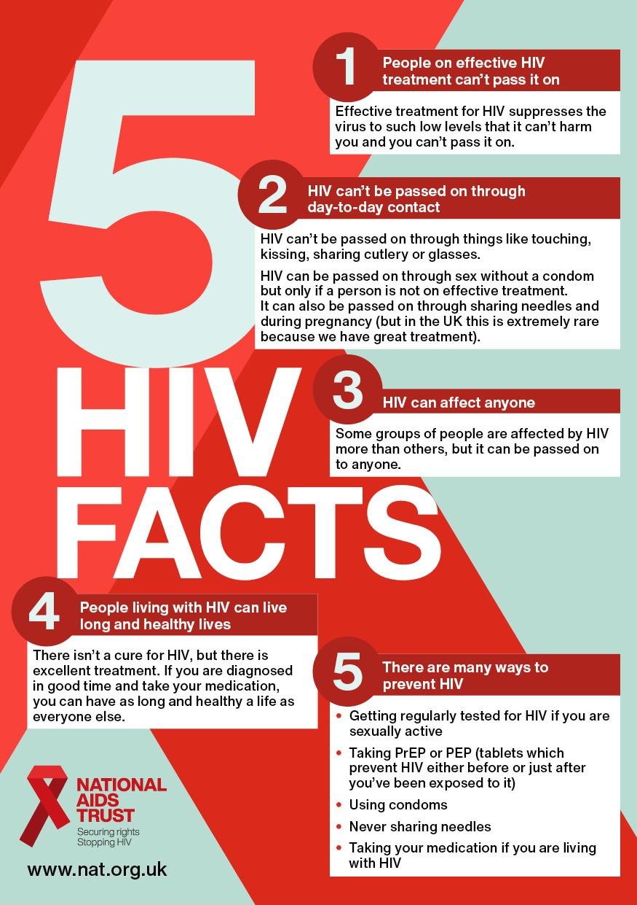
Key takeaways
1
People on effective HIV treatment can't pass it on
Effective treatment for HIV suppresses the virus to such low levels that it can't harm you and you can't pass it on.

Slide 17
Key takeaways
2
HIV can’t be passed on through day-to-day contact
HIV can't be passed on through things like touching, kissing, sharing cutlery or glasses.
HIV can be passed on through sex without a condom but only if a person is not on effective treatment. It can also be passed on through sharing needles and during pregnancy (but in the UK this is extremely rare because we have great treatment).

Slide 18
Key takeaways
3
HIV can affect anyone
Some groups of people are affected by HIV more than others, but it can be passed on to anyone.

Slide 19
Key takeaways
4
People living with HIV can live long and healthy lives
There isn't a cure for HIV, but there is excellent treatment. If you are diagnosed in good time and take your medication, you can have as long and healthy a life as anyone else.

Slide 20
Key takeaways
5
There are many ways to prevent HIV
Getting regularly tested for HIV if you are sexually active
Taking PrEP or PEP (tablets which prevent HIV either before or just after you've been exposed to it)
Using condoms
Never sharing needles
Taking your medication if you are living with HIV

Slide 21

Thank you!

